Slide 1
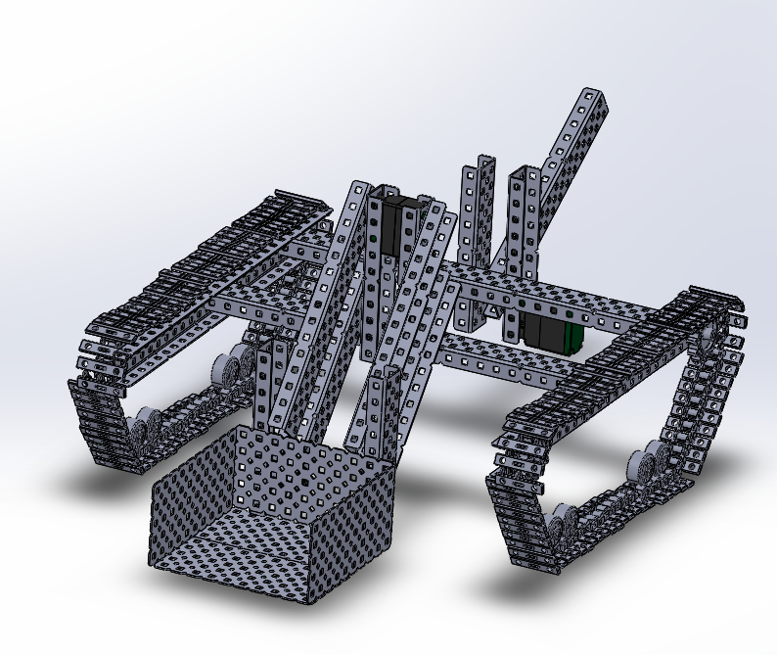
Sala-Slammers
KNW 2300
Mitchell Morrison, Andrew Wright, Garrett Moore, Nathan Wesley, Phuoc Dinh Le, Hadja Kone

Slide 2
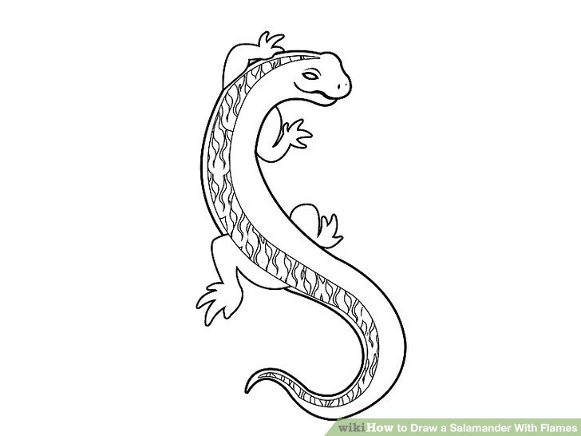
Who are the Sala-Slammers?
Mission: Slam the Salamanders to safety
Vision: Build an effective robot that can accomplish all necessary tasks
Goal: Use clear communication and teamwork throughout the process to win the competition
Notes:
“slam”

Slide 3
OUR PRIORITIES FOR OUR ROBOT ARE STRAIGHT-FORWARD
Fine tune all probes to be as accurate and precise as possible
Perfect our navigation system
Bring the Salamanders to safety

Slide 4

Robot Requirements
Navigate the field autonomously
Collect salamanders
Deploy conductivity probe
Measure temperature
Measure incline
Sense obstacles

Slide 5
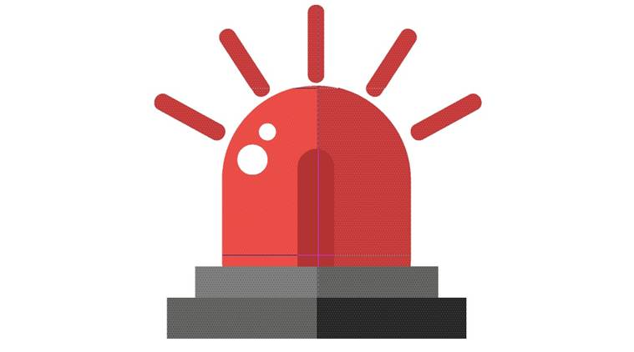
Expected Difficulty
BEACONS!

Slide 6

Our materials (organized by group)
Arduino
Materials that interact directly with the Arduino
Motor Control Board
12V Battery
IR Receiver
Bump Sensors
Motor encoder
360 Servo
5V Regulator
Temperature Probe
2X Water Conductivity probe
Inclinometer
Kill Switch

Slide 7
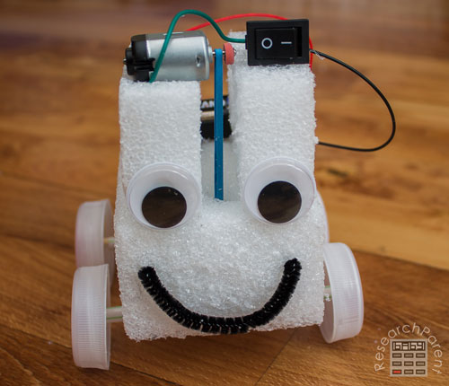
Other Materials
KEY (What each item connects to)
Motor Control Board
Motor Controllers
3/4 Amp Fuses
Whatever needs power
Base/Structure
Bridge
3X Motors
3X Motor Controllers
Motor Encoders
Fuse Block
3/4 Amp fuses
Breadboard
1’ Microrax
¼’’ Acrylic
¼’’ MDF
Popsicle Sticks

Slide 8
Our Budget (necessary items)
Fuse Block (0)
5V Regulator ($50)
Breadboard (0)
3 Amp Fuse x2 ($5)
2X 4 Amp Fuse x2 ($10)
1’ Microrax (0)
1’’ Acrylic (0)
1’’ MDF (0)
Arduino ($200)
Motor control board ($100)
12V Battery ($100)
Kill Switch (0)
3X Motors ($180)
3X Motor controller ($120)
IR Receiver ($15)
2X Bump Sensors ($30)
Motor Encoder ($40)
3X 360 Servo ($150)
Minimum Cost: 1,000 KNW Bucks

Slide 9
Additional items we may need...
An IR sensor ($15)
A thin metal bar at roughly the cost of $150 KNW bucks
Adjusted Total Budget: $1165 KNW bucks

Slide 10
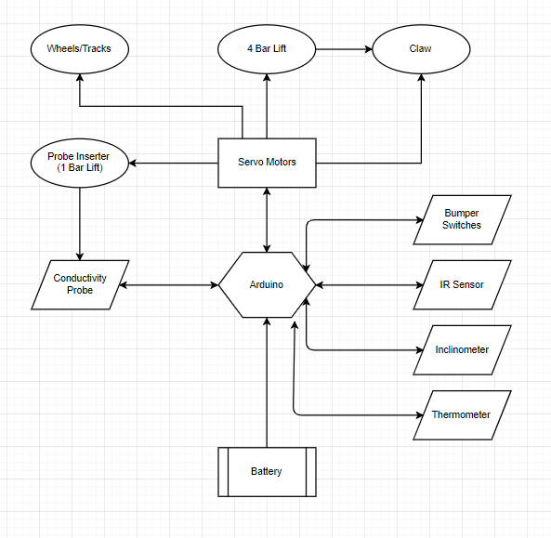
High Level Architectural Block Diagram

Slide 11
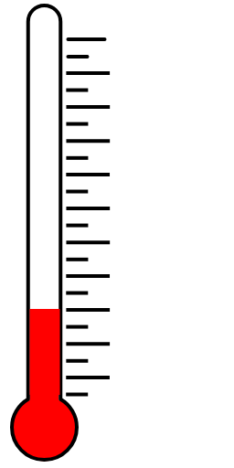
4 functions of the robot
After navigation is complete within each quadrant…
Soil Conductivity
Collect salamanders
Inclinometer reading
Take temperature reading

Slide 12
Soil Conductivity
Our Plan:
Use a metal bar which goes up and down
This bar will be connected to a motor
On the end of the bar is the conductivity probe which will be inserted to the sand

Slide 13
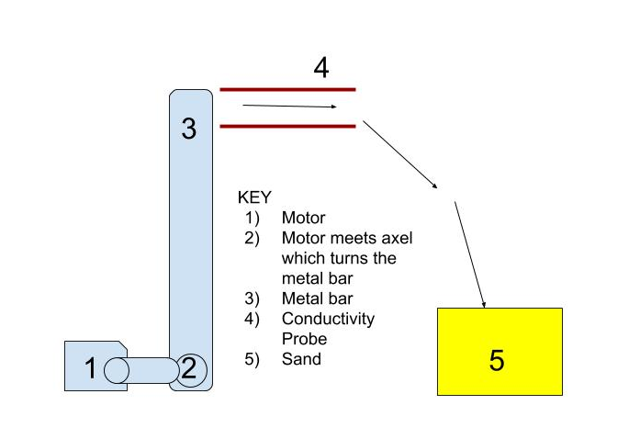
Here’s a mock up

Slide 14
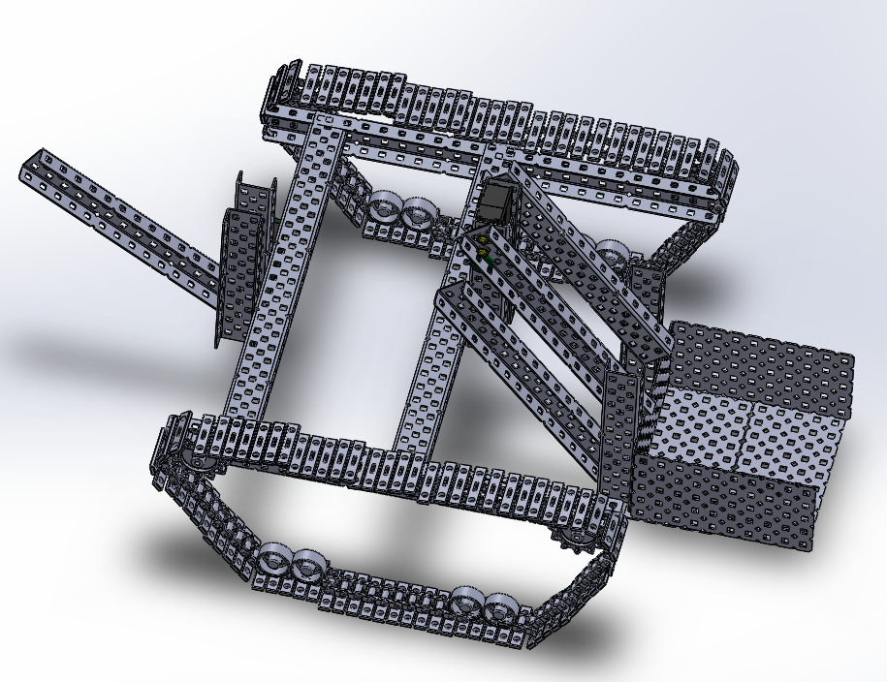
Collecting Salamanders
Brute force scan the entire quadrant:
We will have a scooper attachment that will pick up any salamanders
Our bump sensors will let the robot know to turn along with a dimension plan
It will follow the beacon to the SRZ

Slide 15
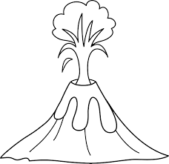
Inclinometer Reading
Once we build the inclinometer…
We will connect it to the arduino
The angle of the volcano will be measured by our device

Slide 16
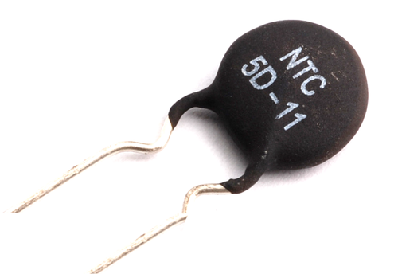
Temperature Reading
Our thermistor will be isolated from any heat generating electrical components of our robot
This way our reading is far more accurate to the surrounding climate and is not influenced by any other pieces
IMG from: https://www.indiamart.com/proddetail/ntc-thermistor-17397824197.html

Slide 17
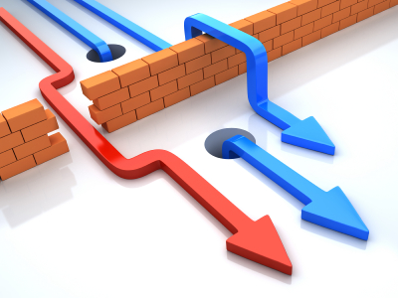
Alternatives
Soil Conductivity
Arm which places the probe
Pulley system drops Cu cladding pieces
Salamander Collection
Navigate and at each collection, bring to SRZ with claw
Bucket with open close doors

Slide 18
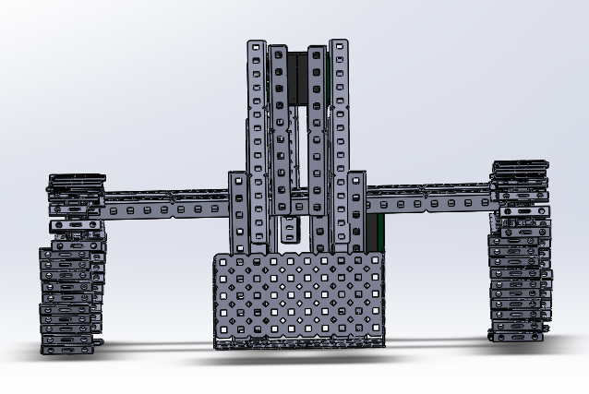
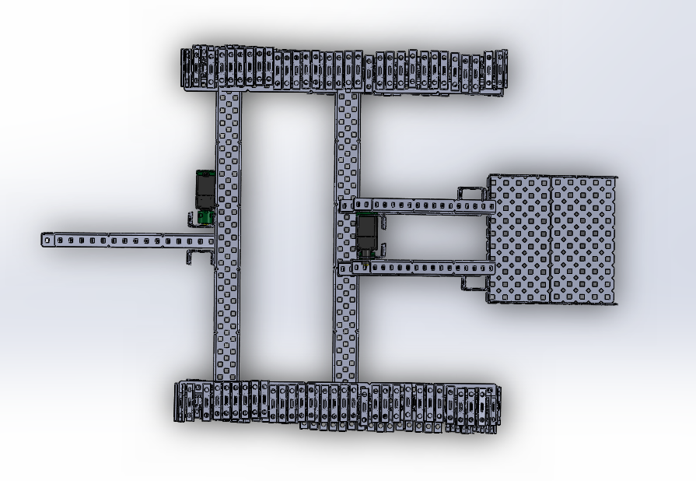
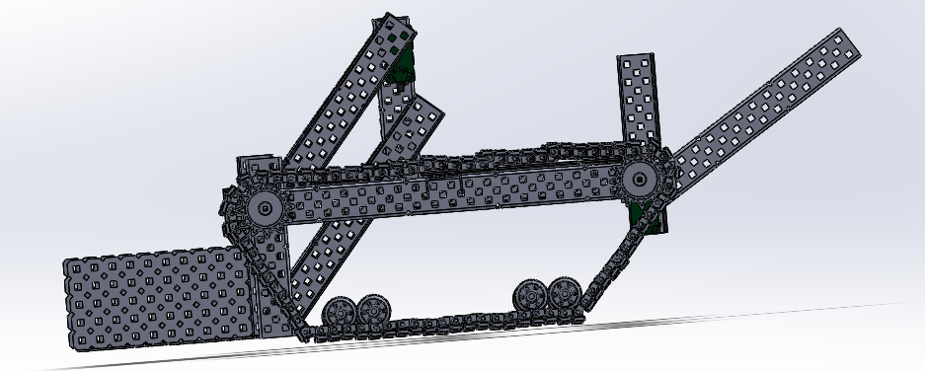
Architectural Layout
Intended Dimensions:
18cm(l) X 20cm(h) X 25cm(w)

Slide 19
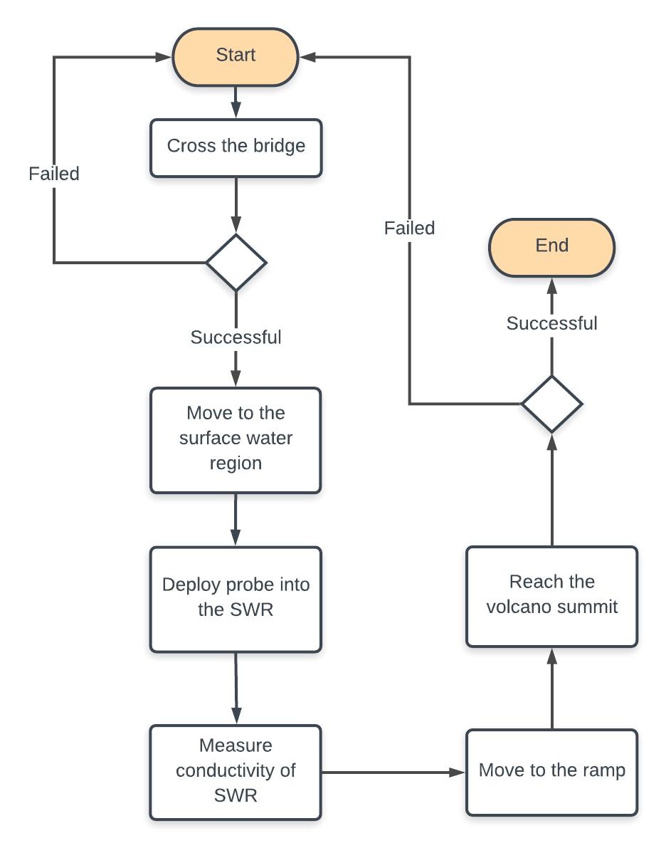
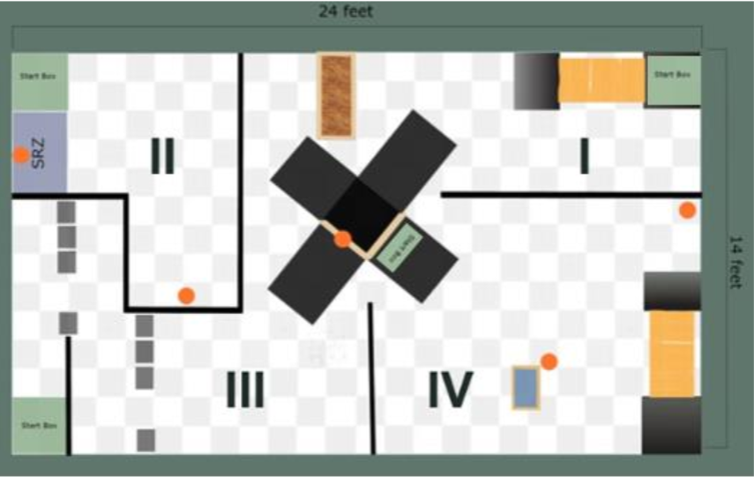
UML Activity
Q1

Slide 20
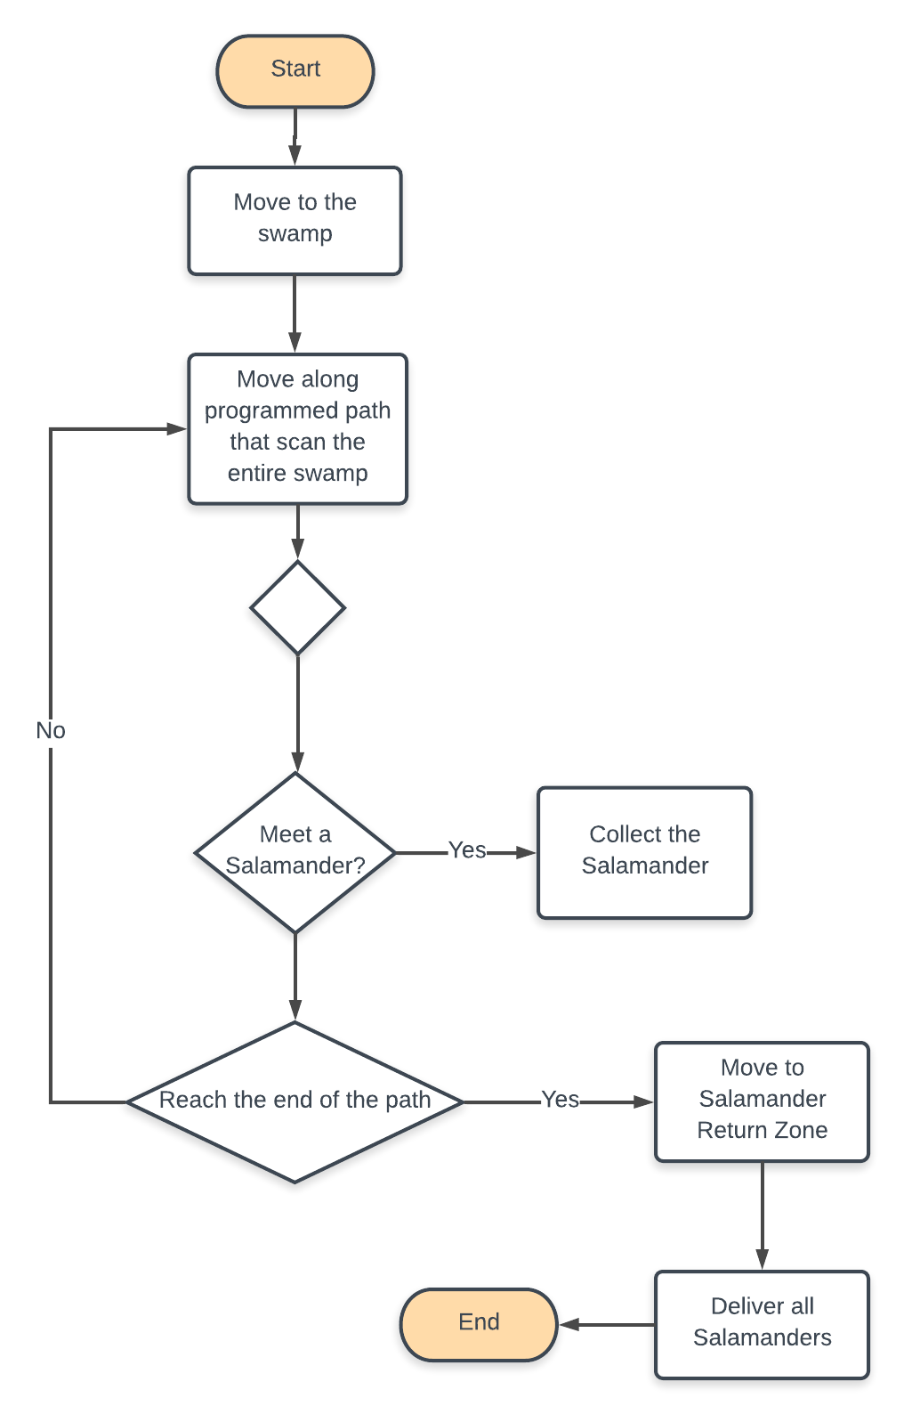
UML Activity
Q2

Slide 21
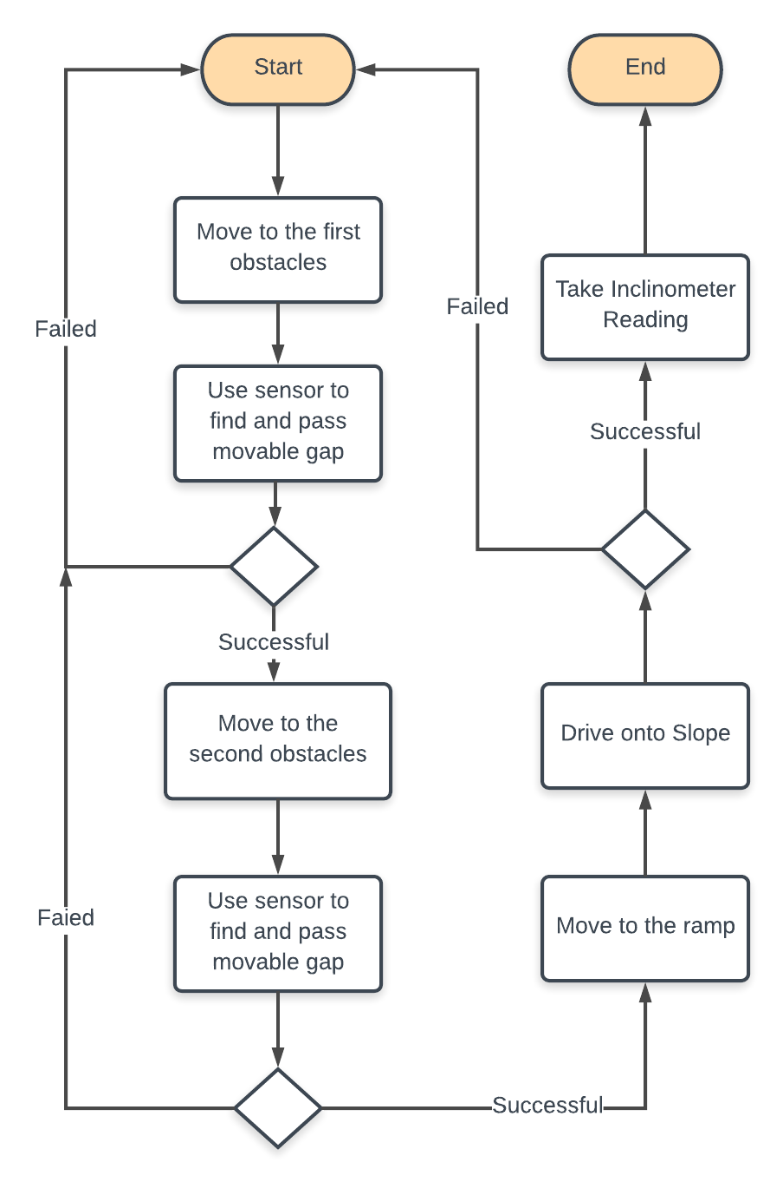
UML Activity
Q3

Slide 22
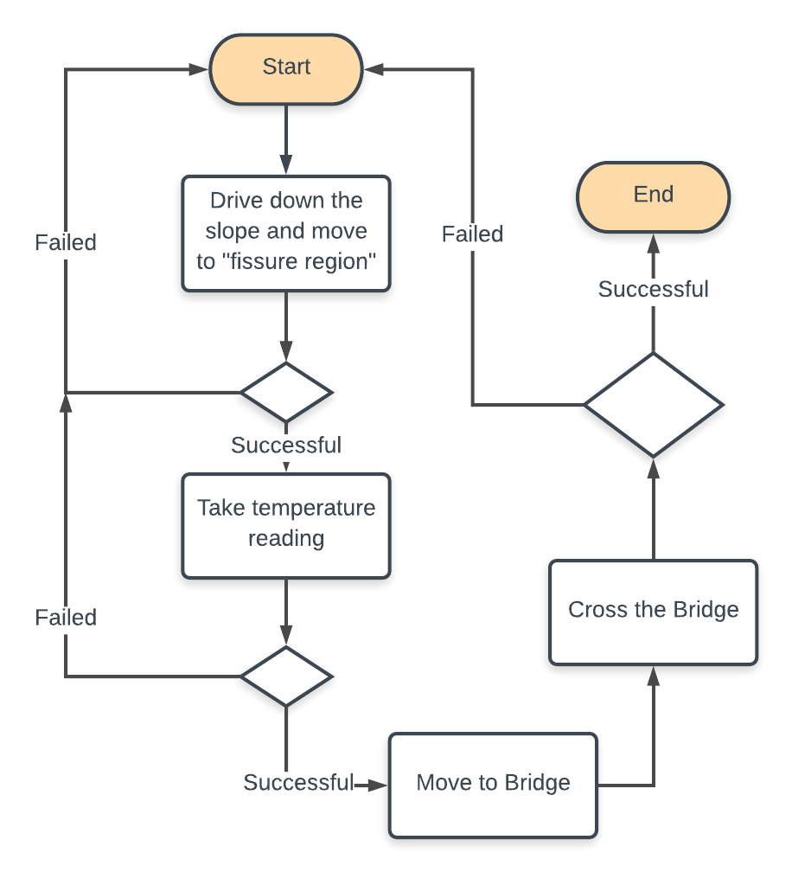
UML Activity
Q4

Slide 23
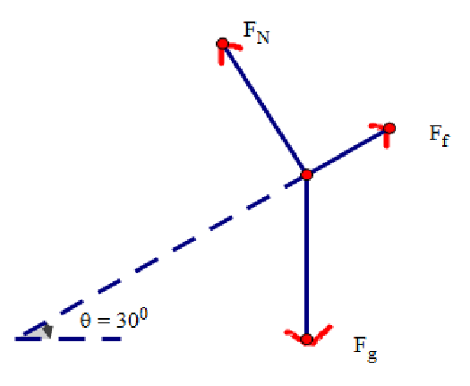
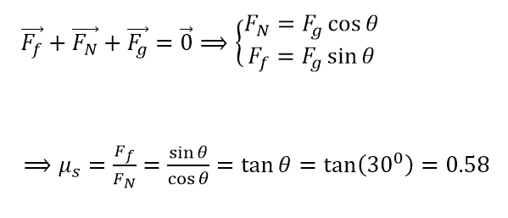
Ramp Physics
Worksheet Calculation
Case 1: Estimated Mass: 1.42 Kg

Slide 24
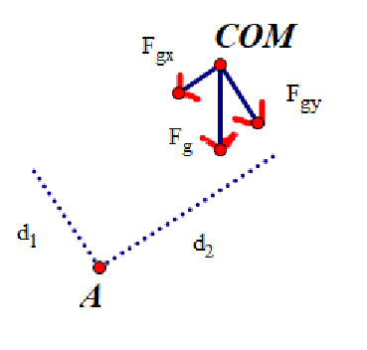
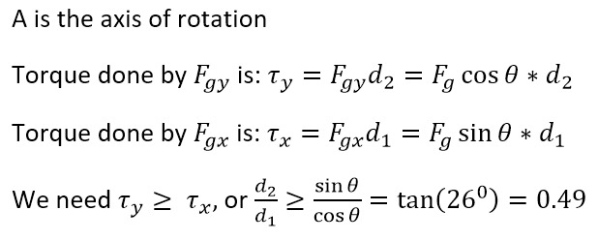
Ramp Physics
Worksheet Calculation
Case 2:

Slide 25
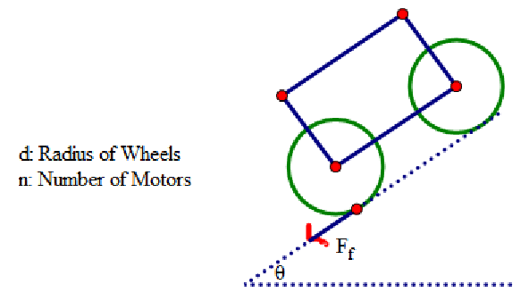
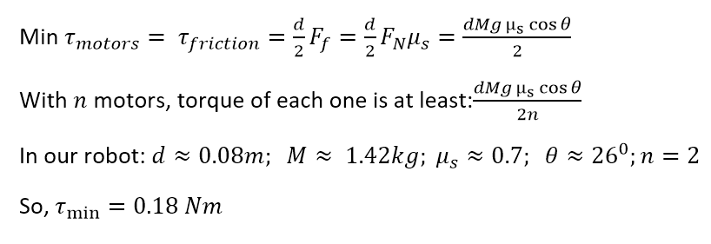
Ramp Physics
Worksheet Calculation
Case 3:

Slide 26
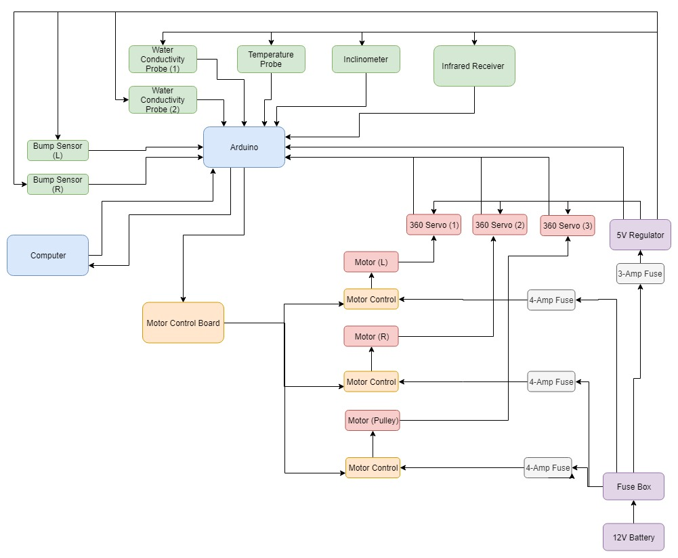
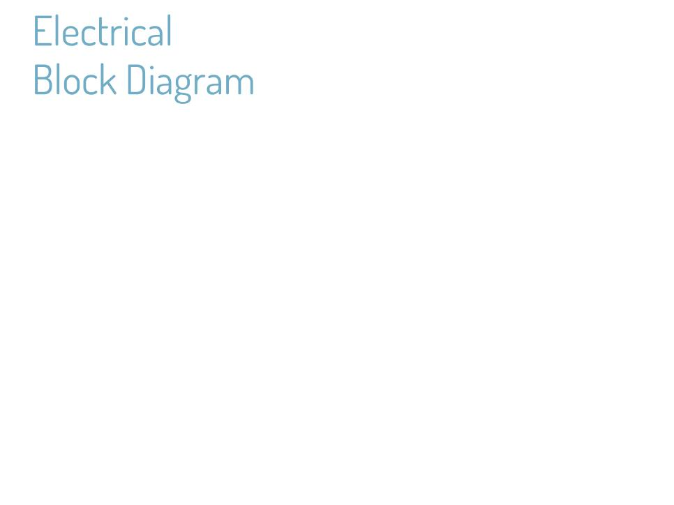

Slide 27
Plan for Beacon Navigation
(Quadrant 1, 2, 4)
Motion of Robot
IR Receiver
(No Connection)
Grid Navigation
Wall limits connection too only if beacon is in front of receiver
Upon losing connection, Robot will turn 90 degrees right
Robot will move if beacon connection is re-established, or will turn 180 degrees
Beacon

Slide 28
Plan for Beacon Navigation
(Quadrant 3)
Trial and error with bump censors to bypass walls
Upon passing 2nd wall
Rotate robot clockwise until connection is lost
Turn 90 degrees counterclockwise
Move to ramp

Slide 29
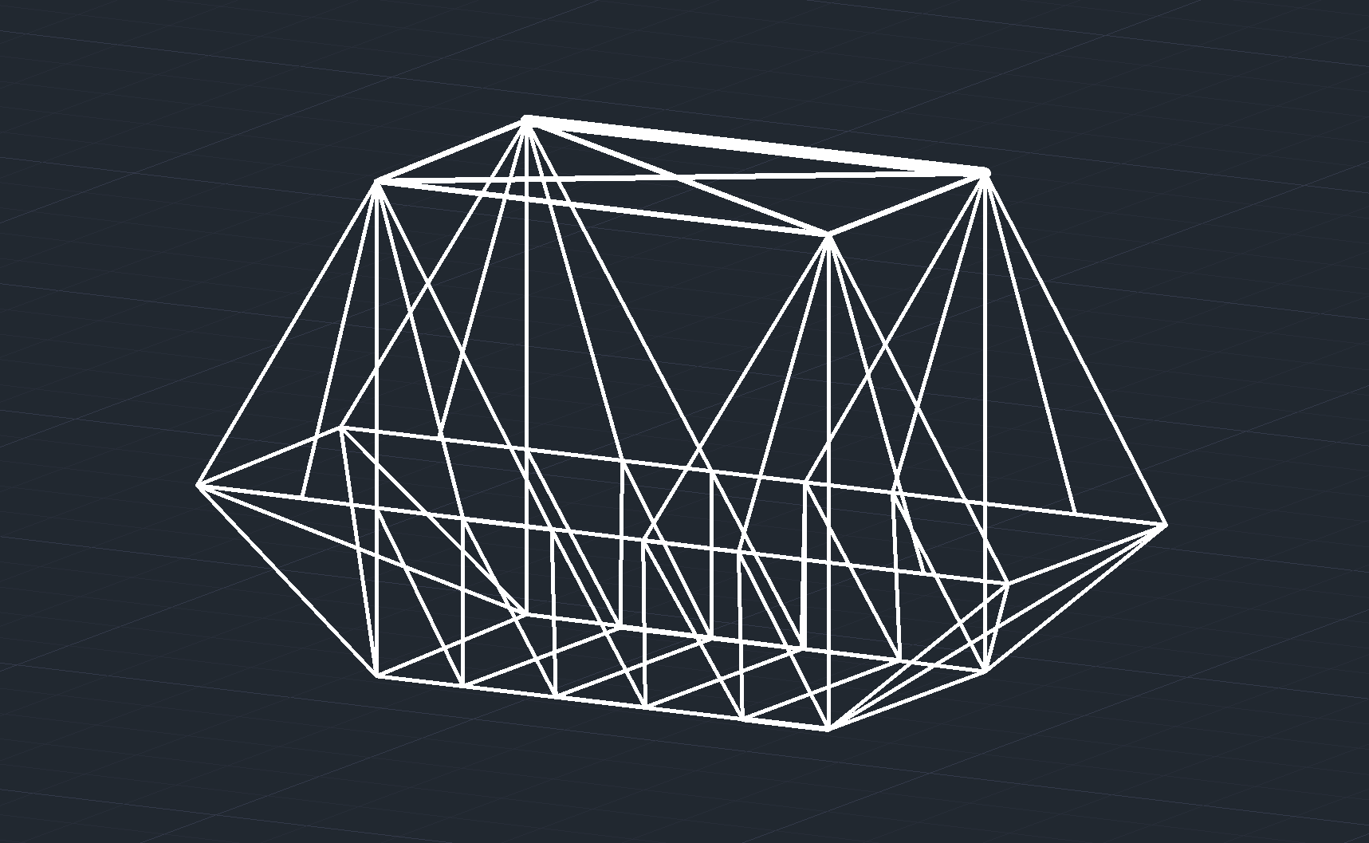
Bridge Design
Truss body will be assisted by a connected triangle upper, similar to a cable-stayed bridge.

Slide 30

How the Sala-Slammers function
Disclaimer: It’s amazing
Fontenot would be so proud
We discuss our goals for each meeting
We divide work based on interests and skills
We ask each other questions to receive input and advice
We have fun with it
What would we call these qualities discussed?
Time commitment
Attention and care to others
Strong motivation
*Fontenot to team Sala-Slammers*

Slide 31
89,526,124
Whoa! That’s a big number, aren’t you proud?

